Slide 1
Perception research
Flash Poll with Dutch Audience – December 6th, 2024
Research Team, ONL LINK Unit

Slide 2
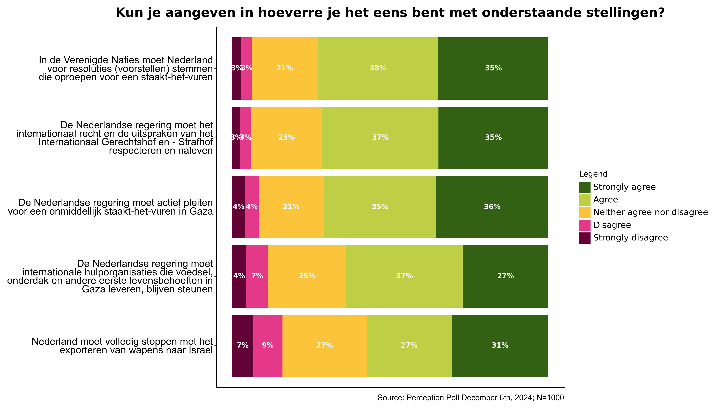
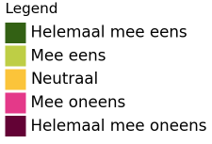
Methodology
Oxfam Novib conducted an online survey, using , Factsnapp, on public opinions related to the Dutch government's decisions in relation to the ongoing conflict in Gaza
Respondents were asked for their level of agreement with 5 statements related to key issues, reflecting perspectives on international diplomacy, peace efforts, and humanitarian aid.
A total of 1000 people participated in the survey.
The sample was weighted based on age range, gender, and household category, providing a representative snapshot of the Dutch population (16+).

Slide 3
Results
The majority of respondents supports actions in favor of immediate ceasefire, international law, and humanitarian aid.
73% of respondents supports UN Ceasefire Resolutions:
  7 out of 10 respondents say that the Dutch government should vote in the United Nations for resolutions calling for a ceasefire in Gaza. (38% strongly agreeing, with 35% agreeing).
72% of respondents says the Dutch Government should respect ICJ and ICC Resolutions:
  7 out of 10 respondents believe that the Netherlands should respect and comply with the international law and the rulings of international courts (35% strongly agreeing, with 37% agreeing)
70% of respondents demands the Dutch government to call for immediate ceasefire in Gaza:
  7 out of 10 respondents say that the Dutch government should advocate for an immediate ceasefire in Gaza (36% strongly agreeing, with 35% agreeing)
64% of respondents says the Dutch government should continue supporting Humanitarian Aid to Gaza:
  6 out of 10 respondents say that the Dutch government should continue to support international aid organizations in Gaza (27% strongly agreeing, with 37% agreeing)
58% of respondents wants a Halting on Arms Exports to Israel:
  6 out of 10 respondents wants that the Netherlands stops exporting weapons to Israel (31% strongly agreeing, with 27% agreeing)

